Slide 1
Establishing Usability of Candidate Data Sources

Slide 2
No business intelligence (BI) and analytics program can be built without information.
That information will originate in data sets coming from many different sources and providers.
That is data requirement analysis is needed
70% of the effort associated with a data warehousing or data mining project is spent on data preparation.

Slide 3
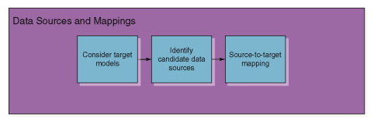
provide enough input to specify which candidate data sources can be extracted, the next step is to consider how that data is to be transformed into a common representation that is then normalized in preparation for consolidation.

Slide 4
Data Profiling

Slide 5
Introduction
The goal of profiling data is to discover metadata when it is not available and to validate metadata when it is available.
Data profiling is a process of analyzing raw data for the purpose of characterizing the information embedded within a data set.

Slide 6
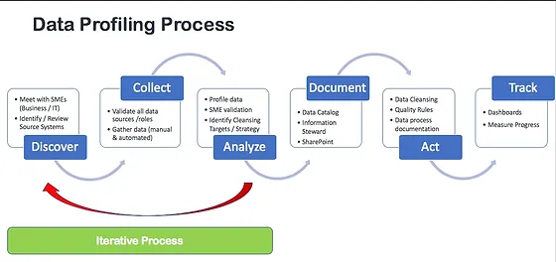

Slide 7
Data profiling steps
Use data profiling at project start to discover if data is suitable for analysis—and make a “go / no go” decision on the project.
Identify and correct data quality issues in source data, even before starting to move it into target database.
Identify data quality issues that can be corrected by Extract-Transform-Load (ETL), while data is moved from source to target. Data profiling can uncover if additional manual processing is needed.
Identify unanticipated business rules, hierarchical structures and foreign key / private key relationships, use them to fine-tune the ETL process.

Slide 8
Data profiling activities
Data model inference, which attempts to derive the data model from undocumented data.
Type inference, a process to determine the data types associated with the data in
each column of a table.
Value range analysis, which explores the possibility that the values within a column fall within a defined value range (such as 0 to 100).
Cardinality and uniqueness, where cardinality refers to the number of discrete values that appear within a column, and uniqueness tests to see that each row in a table has a unique value for any particular set of attributes.
Frequency distribution, which yields the number of times each distinct value appears in a value set.

Slide 9
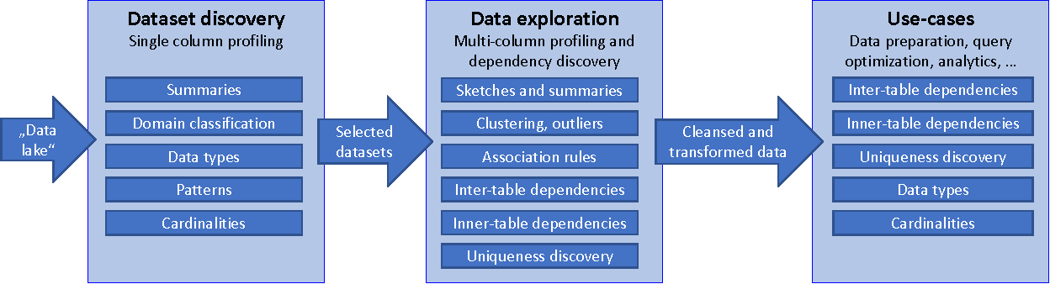

Slide 10
Attribute Analysis

Slide 11
Attribute Analysis
Attribute analysis is a process of looking at all the values populating a particular column as a way to characterize that set of values.
Attribute analysis is the first step in profiling because it yields a significant amount of metadata relating to the data set.

Slide 12
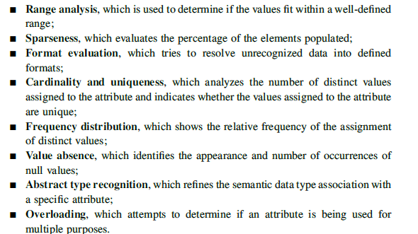

Slide 13
1. Range Analysis
During range analysis a set of values is tested to see if the values fall within a well defined range.
If so, depending on the data type, some inferences may be made.
The range analysis process has six steps, each of which is discussed briefly in the following sections:
Understand the risks
Construct a quantitative model and identify the inputs it requires
Gather inputs and run the model
Check and validate the model
Reconcile the outcomes with reality
Revise the model and its parameters as necessary

Slide 14
Example
Consider an integer column that contains values
between 0 and 9 as well as the value 99 as an error code condition.
A naı¨ve range analyzer might propose 0 through 99 as this attribute range, whereas the more sophisticated analyzer could bisect the values into two ranges, 0 through 9 and the single-valued range of 99.
The more refined the distinct extant value ranges are, the easier it is for the business analyst or domain expert to recognize a meaning in those ranges, which then can be documented as attribute metadata.

Slide 15
2. Sparseness
The degree of sparseness may indicate some business meaning regarding the importance of that attribute.
Depending on the value set, it probably means one of two things.
Either the attribute is extremely important and needs to be available so that in the rare cases there is a need for the value, it can be populated, or the attribute is effectively meaningless because so few records have a value for it.

Slide 16
3. Format Evaluation
look for the existence of patterns that might characterize the values assigned to a column.
use the discovered definition as a validation rule, which we would then add to a metadata repository documenting value domains described using patterns.
examples of rule-based data domains include telephone numbers, zip codes, and social security numbers.
Pattern analysis

Slide 17
One method for pattern analysis is through the superimposition of small, discrete semantic properties to each symbol in a string, slowly building up more interesting patterns as more symbol components have their meanings assigned.

Slide 18
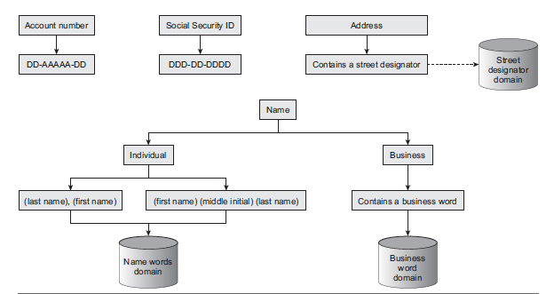

Slide 19
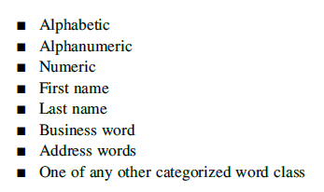
Our next method for pattern analysis takes a more macro view of the data by categorizing strings instead of symbols.
At this point, all strings can be classified as:

Slide 20
4.Cardinality and Uniqueness
The cardinality of a value set is the number of distinct values that exists within a column.
Cardinality is interesting because it relates to different aspects of the correctness of the value set and because of how it exposes business knowledge

Slide 21
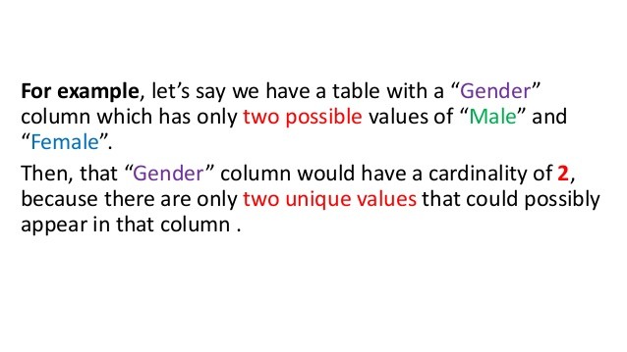

Slide 22
In other contexts, the cardinality of a value set should equal the number of records contributing to that data set.
An example of this is an expected key field:
If the cardinality is less than the number of records, there is at least one duplicate value, which in turn indicates that that field does not contain a true key.
Alternatively, cardinality analysis can be used to find columns whose values are unique, from which candidate keys can be inferred.

Slide 23
5. Frequency Distribution
The frequency distribution of values yields the number of times each of the distinctvalues appears in a value set.
This gives the data consumer some insight into whether certain values have more significance than others based on a high (or low) frequency, and it highlights potential nonconforming values that appear as outliers in the distribution report

Slide 24
The frequency of a particular data value is the number of times the data value occurs.
For example, if four students have a score of 80 in mathematics, and then the score of 80 is said to have a frequency of 4.
The frequency of a data value is often represented by f.

Slide 25
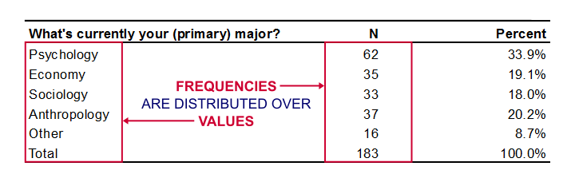

Slide 26
6. Value Absence
There are actually two problems associated with the absence of values that can be explored through data profiling.
The first involves looking for values that are not there, and the second is to look for non-values that are there

Slide 27
The first issue, truly missing values are of significance because the data analyst may be interested in determining whether these values really should be null, under what circumstances they should be null, or perhaps why the value is missing.
The second issue refers to those cases where some distinct value represents one or more kinds of nulls.

Slide 28
Example
any database that carries an attribute for Social Security number and see how many values look like ‘‘000-00-0000’’ and how many like ‘‘999-99-9999.’’
Either of these values is likely intended to convey some kind of missing value, probably the result of a business process that requires filling in a value

Slide 29
7.Abstract Type Analysis
An abstract type is a more semantically descriptive qualification of a type definition that conveys business meaning.
For example, ‘‘people names,’’ ‘‘telephone numbers,’’ and ‘‘ZIP codes’’ are all abstract data types that qualify as character strings.

Slide 30
Typically abstract data types are represented by some kind of semantic definition, including:
Constructive assertion (e.g., all product codes consist of two uppercase characters followed by a hyphen followed by a six-digit number, whose leftmost digit represents the factory at which the product is manufactured);
Value enumeration (e.g., the set of USPS state codes via an enumeration of the valid two uppercase character values);
nattern conformance (e.g., the string matches one or more of a set of defined patterns similar to those inferred via the approach described in the earlier section about Format Evaluation).

Slide 31
8. Overloading Analysis
use of more than one domain by a single attribute might indicate that more complex business rules are in effect, such as the existence of a split attribute, which is characterized by the use of different domains based on other data quality or business rules.

Slide 32
Example
consider a banking application that registers customer account activity.
When a customer makes a deposit, a credit is made to the customer’s account in the form of a positive amount of money; when the customer withdraws money, a debit is made to the account in the form of a negative amount of money.
In this case, the same column is used, but in fact there are two domains used fo rthis attributed positive decimal values

Slide 33
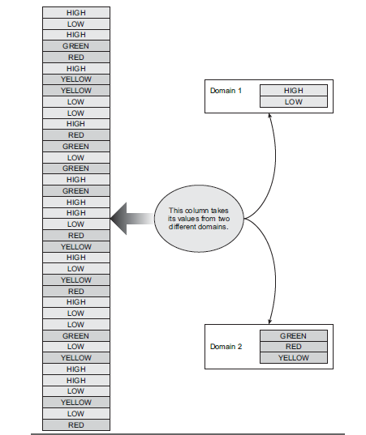

Slide 34
Relationship Analysis

Slide 35
Introduction
Cross-column or relationship analysis focuses on establishing relationships between sets of data.
The goal of these processing stages is to identify relationships between value sets and known reference data, to identify dependencies between columns and to identify key relationships between columns across multiple tables.

Slide 36
1. Domain Analysis
Domain analysis covers two tasks:
identifying data domains and
identifying references to data domains.

Slide 37
domain identification
The number of values is relatively small as compared to the context in which it is used
The values are what we could call intuitively distributed. This means that the distribution, although not always even, will take on characteristics specific to the context. In some cases there is a relatively even distribution; in other cases there may be more weighting given to a small subset of those values.
Other domains exist that may be derived from this domain.
The domain is used in more than one table.
The attribute that uses the value from the domain is rarely null.

Slide 38
identifying references to data domains
1.The attribute’s distinct values are collected and counted.
2. The set of unique values is matched against each domain. Fast matching techniques
are used for scalability.
3. For each domain, we compute three ratio values. The agreement and disagreement

Slide 39
